Slide 1
Remote Method Invocation

Slide 2
Java Remote Method Invocation
The Java Remote Method Invocation (Java RMI) is a Java API that performs remote method invocation, the object-oriented equivalent of remote procedure calls (RPC), with support for direct transfer of serialized Java classes and distributed garbage-collection.
The original implementation depends on Java Virtual Machine (JVM) class-representation mechanisms and it thus only supports making calls from one JVM to another.
The protocol underlying this Java-only implementation is known as Java Remote Method Protocol (JRMP).

Slide 3
Remote Method Invocation (RMI)
Remote Method Invocation (RMI) is an API which allows an object to invoke a method on an object that exists in another address space, which could be on the same machine or on a remote machine.
Through RMI, object running in a JVM present on a computer (Client side) can invoke methods on an object present in another JVM (Server side).
RMI creates a public remote server object that enables client and server side communications through simple method calls on the server object.

Slide 4
Remote Method Invocation
The RMI (Remote Method Invocation) is an API that provides a mechanism to create distributed application in java.
The RMI allows an object to invoke methods on an object running in another JVM.
The RMI provides remote communication between the applications using two objects stub and skeleton.

Slide 5
Java Remote Method Invocation Distributed Computing for Java
Java Remote Method Invocation (RMI) allows you to write distributed objects using Java.
The benefits of RMI, and how you can connect it to existing and legacy systems as well as to components written in Java.
RMI provides a simple and direct model for distributed computation with Java objects.
These objects can be new Java objects, or can be simple Java wrappers around an existing API.
Java embraces the "Write Once, Run Anywhere model. RMI extends the Java model to be run everywhere."
Because RMI is centered around Java, it brings the power of Java safety and portability to distributed computing. You can move behavior, such as agents and business logic, to the part of your network where it makes the most sense. When you expand your use of Java in your systems, RMI allows you to take all the advantages with you.

Slide 6
Goals of RMI
To minimize the complexity of the application.
To preserve type safety.
Distributed garbage collection.
Minimize the difference between working with local and remote objects.

Slide 7
Distributed Architecture
Distributed Architecture
Distributed architecture splits the presentation tier and middle tier physically and logically to run in different servers. This is a complex architecture with significant overhead.
The architecture uses RMI between presentation tier and middle tier.
This makes remote invocation a major determinant of performance and design consideration.
It forces to minimize number of remote calls.
Strengths of this architecture
It can support different type of clients by providing a shared middle tier.
It permits the distribution of application components across different physical servers.
Weakness of this architecture
It is a complex approach should be chosen only if the requirement dictates.
It affects performance. Remote method calls can be hundred of times slower than local calls.
This will determine the overall performance of the application.
Distributed applications are hard to test and debug, because it is heavily dependent on container service.
OO design is severely hampered by the central use of RMI.
Exception handlings are more complex. Must handle both application failure and transport failure.
Should rely on third party application server.
Complex to deploy.

Slide 8
Comparison of Distributed and Non distributed Java Programs
Distributed Architecture
Distributed architecture splits the presentation tier and middle tier physically and logically to run in different servers. This is a complex architecture with significant overhead.
The architecture uses RMI between presentation tier and middle tier.
This makes remote invocation a major determinant of performance and design consideration.
It forces to minimize number of remote calls.
Strengths of this architecture
It can support different type of clients by providing a shared middle tier.
It permits the distribution of application components across different physical servers.
Weakness of this architecture
It is a complex approach should be chosen only if the requirement dictates.
It affects performance. Remote method calls can be hundred of times slower than local calls.
This will determine the overall performance of the application.
Distributed applications are hard to test and debug, because it is heavily dependent on container service.
OO design is severely hampered by the central use of RMI.
Exception handlings are more complex. Must handle both application failure and transport failure.
Should rely on third party application server.
Complex to deploy.

Slide 9
Non-Distributed Architecture
Non-Distributed Architecture
In this architecture, presentation tier and middle tier of the application run in the same server.
So the business components can be accessed locally without remote calls; this will improve significant performance
of the overall application. However it is vital that presentation tier and middle tier are kept logically distinct.
The main risk in the web application is that blurred responsibilities between presentation and business logic components.
Strengths of this architecture
Simplest architecture for web applications
Application can be developed faster
Can implement good OO design
Scales well. Can cluster to handle larger number of request.
Less cost, many open-source stable web containers are available.
Weakness of this architecture
This architecture supports only web interface clients.
The whole application run in a single server while it boost performance, components cannot freely allocated to
different physical layers.
Need to write code to manage transactions.
Need to write code for concurrent threading issues.
In most cases J2EE is used to build web applications.
Thus, a J2EE web-container can provide the entire infrastructure required by many applications.
Except entity bean all other services can be used in web-container such as JMX, JMS, JDBC, JavaMail, Database
Transaction and Connection Pooling.

Slide 10
Comparison of Distributed and Non distributed Java Programs

Slide 11
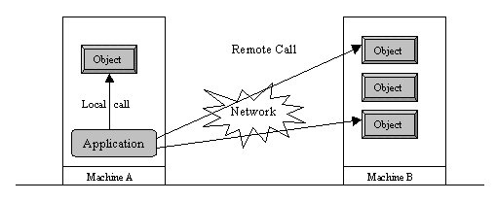
Local v. Remote method invocation

Slide 12
RMI System Architecture
The design goal for the RMI architecture was to create a Java distributed object model that integrates naturally into the Java programming language and the local object model.
RMI architects have succeeded; creating a system that extends the safety and robustness of the Java architecture to the distributed computing world.

Slide 13
RMI System Architecture
RMI is implemented as three layers:
A stub program in the client side of the client/server relationship, and a corresponding skeleton at the server end.
A Remote Reference Layer
A Transport Connection Layer
The RMI architecture is based on one important principle:
the definition of behavior and the implementation of that behavior are separate concepts.
RMI allows the code that defines the behavior and the code that implements the behavior to remain separate and to run on separate JVMs.

Slide 14
RMI System Architecture
Specifically, in RMI, the definition of a remote service is coded using a Java interface.
The implementation of the remote service is coded in a class.
Therefore, the key to understanding RMI is to remember that interfaces define behavior and classes define implementation.

Slide 15
RMI System Architecture
Client Program
Sever Program
Interface
Implementation
RMI System

Slide 16
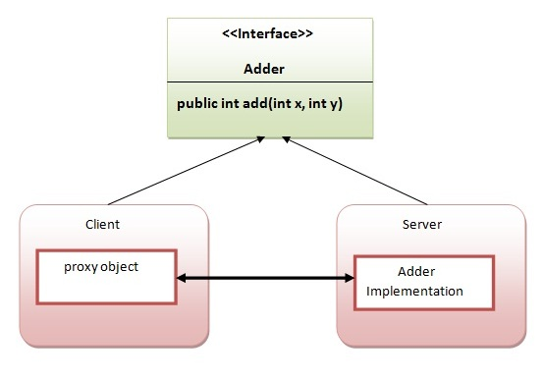
RMI System Architecture
a Java interface does not contain executable code.
RMI supports two classes that implement the same interface.
The first class is the implementation of the behavior, and it runs on the server.
The second class acts as a proxy for the remote service and it runs on the client. This is shown in the following diagram.

Slide 17
RMI System Architecture
A client program makes method calls on the proxy object, RMI sends the request to the remote JVM, and forwards it to the implementation.
Any return values provided by the implementation are sent back to the proxy and then to the client's program.

Slide 18
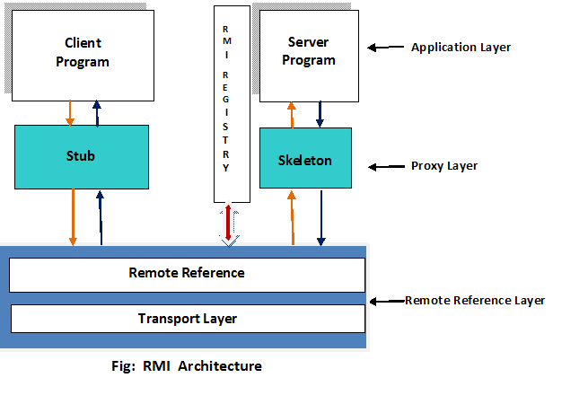
RMI System Architecture

Slide 19
RMI System Architecture
The stub/skeleton layer - client-side stubs (proxies) and server-side skeletons
The remote reference layer - remote reference behavior (such as invocation to a single object or to a replicated object)
The transport layer - connection set up and management and remote object tracking

Slide 20
RMI System Architecture
A remote method invocation from a client to a remote server object travels down through the layers of the RMI system to the client-side transport, then up through the server-side transport to the server.
Client sends its request of method invocation (to be executed on remote server) to stub.
Stub in turn sends the request to skeleton.
Skeleton passes the request to the server program.
Server executes the method and sends the return value to the skeleton (to route to client).
Skeleton sends to stub and stub to client program.

Slide 21
The stub/skeleton layer
The stub/skeleton layer is the interface between the application layer and the rest of the RMI system.
Stubs and skeletons are generated using the RMIC compiler
This layer does not deal with specifics of any transport.
It transmits data to the remote reference layer via the abstraction of marshal streams.

Slide 22
A stub for a remote object is the client-side proxy for the remote object
a stub implements all the interfaces that are supported by the remote object implementation
A client-side stub is responsible for:
It initiates a connection with remote Virtual Machine (JVM),
It writes and transmits (marshals) the parameters to the remote Virtual Machine (JVM),
It waits for the result
It reads (unmarshals) the return value or exception, and
It finally, returns the value to the caller.

Slide 23
skeleton
The skeleton is an object, acts as a gateway for the server side object.
All the incoming requests are routed through it.
When the skeleton receives the incoming request, it does the following tasks:
It reads the parameter for the remote method
It invokes the method on the actual remote object, and
It writes and transmits (marshals) the result to the caller.

Slide 24
Marshaling and Unmarshaling
Marshaling is nothing but converting data into a special format suitable to pass through the distributed environment without loosing object persistence.
For this reason, the RMI mechanism implicitly serialize the objects involved in communication.
The stub marshals the data of client and then sends to the skeleton.
As the format is not understood by the server program, it is unmarshaled by the skeleton into the original format and passed to server.
Similarly from server to client also.

Slide 25
Remote Reference Layer
Proxies are implicitly connected to RMI mechanism through Remote reference layer
Layer responsible for
object communication and transfer of objects between client and server.
dealing with semantics of remote invocations and implementation – specific tasks with remote object.
actual implementation of communication protocols is handled.

Slide 26
Transport layer
Transport layer is responsible for actually setting up connections and handling the transport of data from one machine to another.
It can be modified to handle encrypted streams, compression algorithms and a number of other security/performance related enhancements.
The Transport Layer makes the connection between JVMs.
All connections are stream-based network connections that use TCP/IP.

Slide 27
Naming Remote Objects
"How does a client find an RMI remote service?
Clients find remote services by using a naming or directory service.
RMI can use many different directory services, including the Java Naming and Directory Interface (JNDI).
RMI itself includes a simple service called the RMI Registry,rmiregistry.
The RMI Registry runs on each machine that hosts remote service objects and accepts queries for services, by default on port 1099.

Slide 28
On a host machine, a server program creates a remote service
a local object that implements that service.
it exports that object to RMI.
When the object is exported, RMI creates a listening service that waits for clients to connect and request the service.
After exporting, the server registers the object in the RMI Registry under a public name.

Slide 29
On the client side, the RMI Registry is accessed through the static class Naming.
It provides the method lookup() that a client uses to query a registry.
The method lookup () accepts a URL that specifies the server host name and the name of the desired service.
The method returns a remote reference to the service object.
The URL takes the form:
rmi://<host_name> [:<name_service_port>]/<service_name>

Slide 30
where the host_name is a name recognized on the local area network (LAN) or a DNS name on the Internet.
The name_service_port only needs to be specified only if the naming service is running on a different port to the default 1099.

Slide 31
RMI Registry
RMI registry is a namespace on which all server objects are placed. Each time the server creates an object, it registers this object with the RMIregistry (using bind() or reBind() methods). These are registered using a unique name known as bind name.
To invoke a remote object, the client needs a reference of that object. At that time, the client fetches the object from the registry using its bind name (using lookup() method).

Slide 32
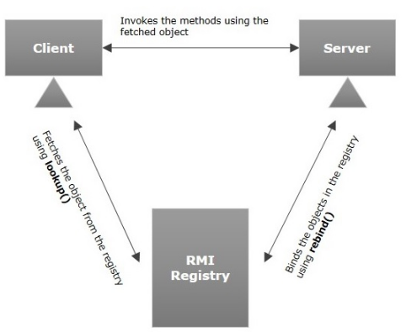

Slide 33
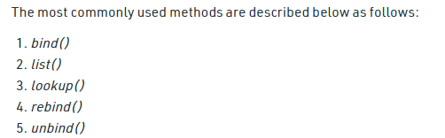
Naming Remote Objects
Java.rmi.Naming class contains a method to bind, unbind or rebind names with a remote object present at the remote registry.
This class is also used to get the reference of the object present at remote registries or the list of name associated with this registry.
Syntax: Class declaration
public final class Naming extends Object

Slide 34
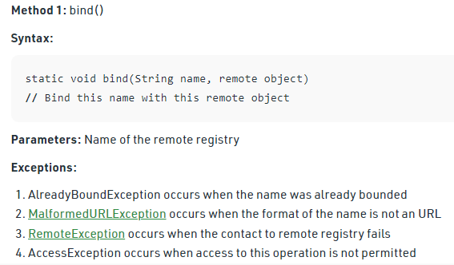
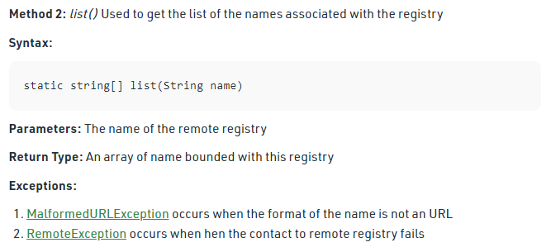

Slide 35
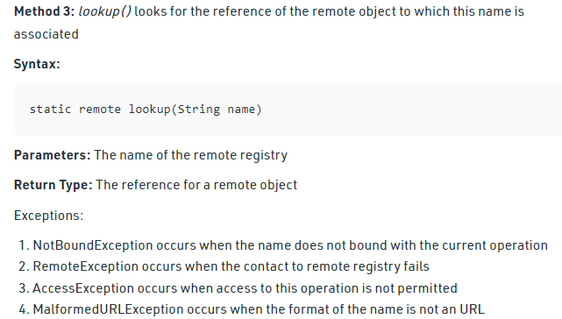
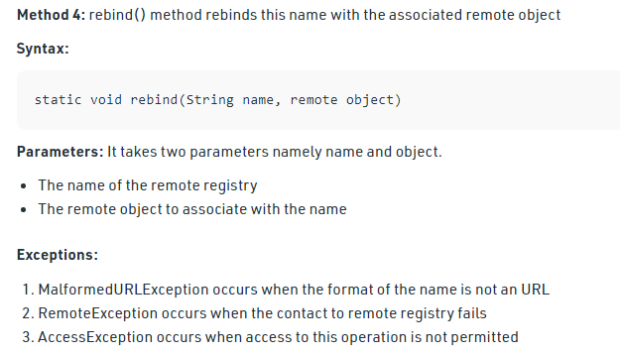

Slide 36
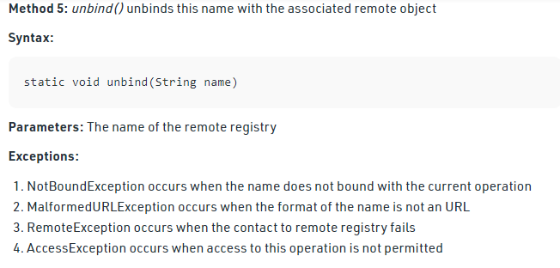

Slide 37
Using RMI
A working RMI system is composed of several parts.
Interface definitions for the remote services
Implementations of the remote services
Stub and Skeleton files
A server to host the remote services
An RMI Naming service that allows clients to find the remote services
A class file provider (an HTTP or FTP server)
A client program that needs the remote services

Slide 38
Interfaces
The first step is to write and compile the Java code for the service interface.
Implementation
Next, you write the implementation for the remote service.
Stubs and Skeletons
You next use the RMI compiler, rmic, to generate the stub and skeleton files.
The compiler runs on the remote service implementation class file.
Host Server
Remote RMI services must be hosted in a server process.
Client

Slide 39
1) create the remote interface
For creating the remote interface, extend the Remote interface and declare the RemoteException with all the methods of the remote interface.
import java.rmi.*;
public interface Adder extends Remote{
public int add(int x,int y)throws RemoteException;
}

Slide 40
2) Provide the implementation of the remote interface
Now provide the implementation of the remote interface.
For providing the implementation of the Remote interface, we need to Either extend the UnicastRemoteObject class,
or use the exportObject() method of the UnicastRemoteObject class
In case, you extend the UnicastRemoteObject class, you must define a constructor that declares RemoteException.

Slide 41
import java.rmi.*;
import java.rmi.server.*;
public class AdderRemote extends UnicastRemoteObject implements Adder{
AdderRemote()throws RemoteException{
super();
}
public int add(int x,int y){return x+y;}
}

Slide 42
3.create the stub and skeleton objects using the rmic tool.
Next step is to create stub and skeleton objects using the rmi compiler.
The rmic tool invokes the RMI compiler and creates stub and skeleton objects.
rmic AdderRemote

Slide 43
4) Start the registry service by the rmiregistry tool
Now start the registry service by using the rmiregistry tool.
If you don't specify the port number, it uses a default port number.
In this example, we are using the port number 5000.
rmiregistry 5000

Slide 44
5. Create and run the server application
Now rmi services need to be hosted in a server process.
The Naming class provides methods to get and store the remote object.
The Naming class provides 5 methods.

Slide 45
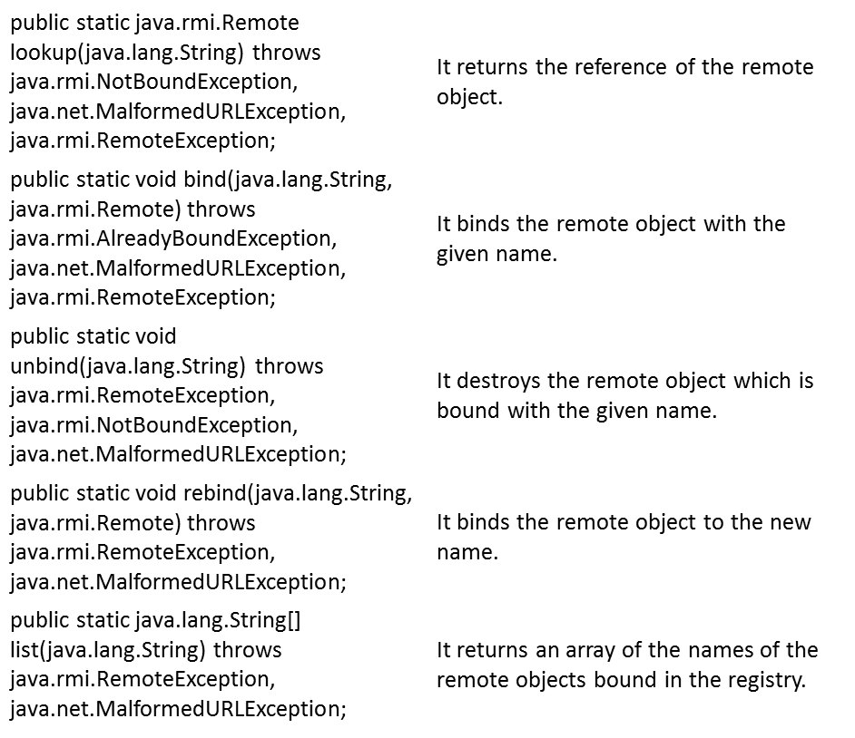

Slide 46
import java.rmi.*;
import java.rmi.registry.*;
public class MyServer{
public static void main(String args[]){
try{
Adder stub=new AdderRemote();
Naming.rebind("rmi://localhost:5000/GPP",stub);
}catch(Exception e){System.out.println(e);}
}
}

Slide 47
6.Create and run the client application
At the client we are getting the stub object by the lookup() method of the Naming class and invoking the method on this object.
In this example, we are running the server and client applications, in the same machine so we are using localhost.
If you want to access the remote object from another machine, change the localhost to the host name (or IP address) where the remote object is located.

Slide 48
import java.rmi.*;
public class MyClient{
public static void main(String args[]){
try{
Adder stub=(Adder)Naming.lookup("rmi://localhost:5000/GPP");
System.out.println(stub.add(34,4)); }catch(Exception e){}
}
}

Slide 49
For running this rmi example,
1) compile all the java files
javac *.java
2)create stub and skeleton object by rmic tool
rmic AdderRemote
3)start rmi registry in one command prompt
rmiregistry 5000
4)start the server in another command prompt
java MyServer
5)start the client application in another command prompt
java MyClient

Slide 50
RMI Registry
the RMI registry is a simple server-side bootstrap naming facility that allows remote clients to get a reference to a remote object
Servers name and register their objects to be accessed remotely with the RMI Registry.
Clients use the name to find server objects and obtain a remote reference to those objects from the RMI Registry.
A registry (using the rmiregistry command) is a separate process running on the server machine.

Slide 51
RMI Registry Architecture
Java Virtual Machine
Java Virtual Machine
Client
Remote Object
Skeleton
Server
Stub
Registry
“Bob”
Java Virtual Machine

